Slide 2
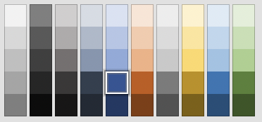
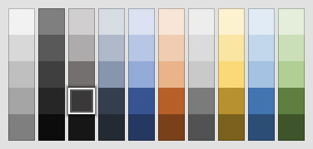
Margins
Do not use this space!
Titles : Arial, Bold, 24pt, blue
Subtitles : Arial, Regular, 20pt
Main text : Arial, Regular, 16pt, Dark grey
Nullam id dolor id nibh ultricies vehicula ut id elit. Vestibulum id ligula porta felis euismod semper. Nullam quis risus eget urna mollis ornare vel eu leo. Nulla vitae elit libero, a pharetra augue. Nulla vitae elit libero, a pharetra augue.
Maecenas faucibus mollis interdum. Integer posuere erat a ante venenatis dapibus posuere velit aliquet. Curabitur blandit tempus porttitor. Cras justo odio, dapibus ac facilisis in, egestas eget quam. Cum sociis natoque penatibus et magnis dis parturient montes, nascetur ridiculus mus.
Arial font ONLY please Important : ALWAYS have the NMEU logo slide at the beginning of ALL presentations
Margins
Do not use
this space!
Margins
Do not use
this space!

Slide 3
Titles
Subtitles
Main text

